Slide 1
Introduction to R
Rajasekhar Jetty

Slide 2
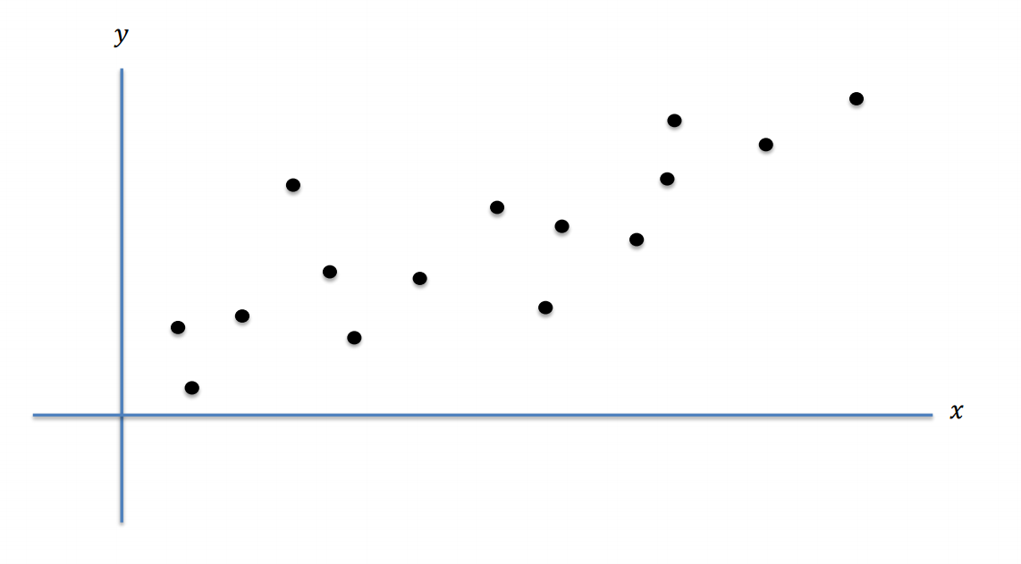
Fitting Linear Model

Slide 3
Linear Regression (used to fit linear models)
Usage : Modeling the relationship between a scalar dependent variable y and one or more explanatory variables (or independent variables) denoted X
Package : class sklearn.linear_model.LinearRegression
Command : class sklearn.linear_model.LinearRegression(fit_intercept=True, normalize=False, copy_X=True,n_jobs=1)

Slide 4
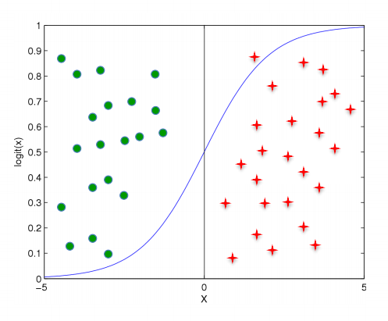
Logistic Regression

Slide 5
Logistic Regression
Usage : Regression model where the dependent variable (DV) is categorical.
Measures the relationship between the categorical dependent variable and one or more independent variables by estimating probabilities using a logistic function, which is the cumulative logistic distribution
Logistic Function : logistic function or logistic curve is a common "S" shape (sigmoid curve)
Package : class sklearn.linear_model.LogisticRegression
Command : class sklearn.linear_model.LogisticRegression(penalty='l2', dual=False, tol=0.0001, C=1.0, fit_intercept=True,intercept_scaling=1, class_weight=None, random_state=None, solver='liblinear', max_iter=100, multi_class='ovr',verbose=0, warm_start=False, n_jobs=1)

Slide 6
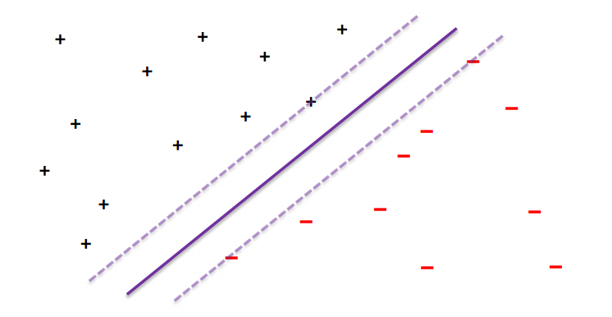
Support Vector Machines

Slide 7
Support Vector Machines
Usage : Supervised learning models with associated learning algorithms that analyze data used for classification and regression analysis
Package : class sklearn.svm.SVC
SVC, NuSVC and LinearSVC - Used for classification.
SVR, NuSVR and LinearSVR - Support Vector Regression
Command :
class sklearn.svm.SVC(C=1.0, cache_size=200, class_weight=None, coef0=0.0, decision_function_shape=None, degree=3, gamma='auto', kernel='rbf', max_iter=-1, probability=False, random_state=None, shrinking=True, tol=0.001, verbose=False)

Slide 8
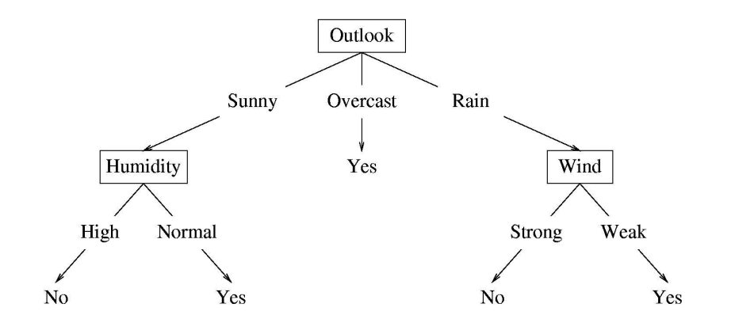
Trees

Slide 9
rpart
Usage : Supervised learning models with associated learning algorithms that analyze data used for classification and regression analysis
Package : class sklearn.tree.DecisionTreeClassifier
class sklearn.tree.DecisionTreeRegressor
Command :
class sklearn.tree.DecisionTreeClassifier(criterion='gini', splitter='best', max_depth=None, min_samples_split=2,min_samples_leaf=1, min_weight_fraction_leaf=0.0, max_features=None, random_state=None, max_leaf_nodes=None,class_weight=None, presort=False)

Slide 10
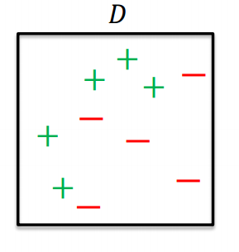
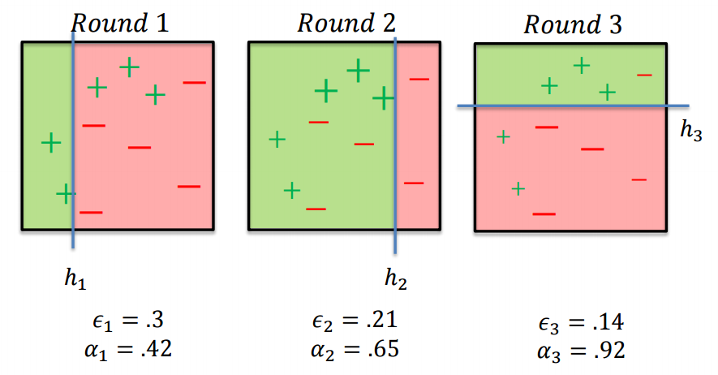
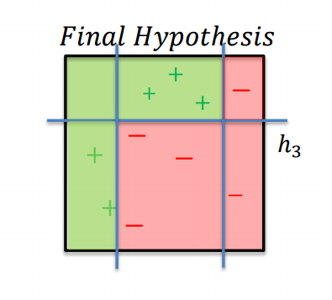
AdaBoost

Slide 11
AdaBoost & Gradient Boosted Machine
AdaBoost
Usage : conjunction with many other types of learning algorithms to improve their performance
Package : class sklearn.ensemble.AdaBoostClassifier
Command :
class sklearn.ensemble.AdaBoostClassifier(base_estimator=None, n_estimators=50, learning_rate=1.0,algorithm='SAMME.R', random_state=None)

Slide 12
AdaBoost & Gradient Boosted Machine
Gradient Boosted
Usage : Prediction model in the form of an ensemble of weak prediction models, typically decision trees
Package : class sklearn.ensemble.GradientBoostingClassifier
Command :
class sklearn.ensemble.GradientBoostingClassifier(loss='deviance', learning_rate=0.1, n_estimators=100,subsample=1.0, min_samples_split=2, min_samples_leaf=1, min_weight_fraction_leaf=0.0, max_depth=3, init=None,random_state=None, max_features=None, verbose=0, max_leaf_nodes=None, warm_start=False,presort='auto')

Slide 13
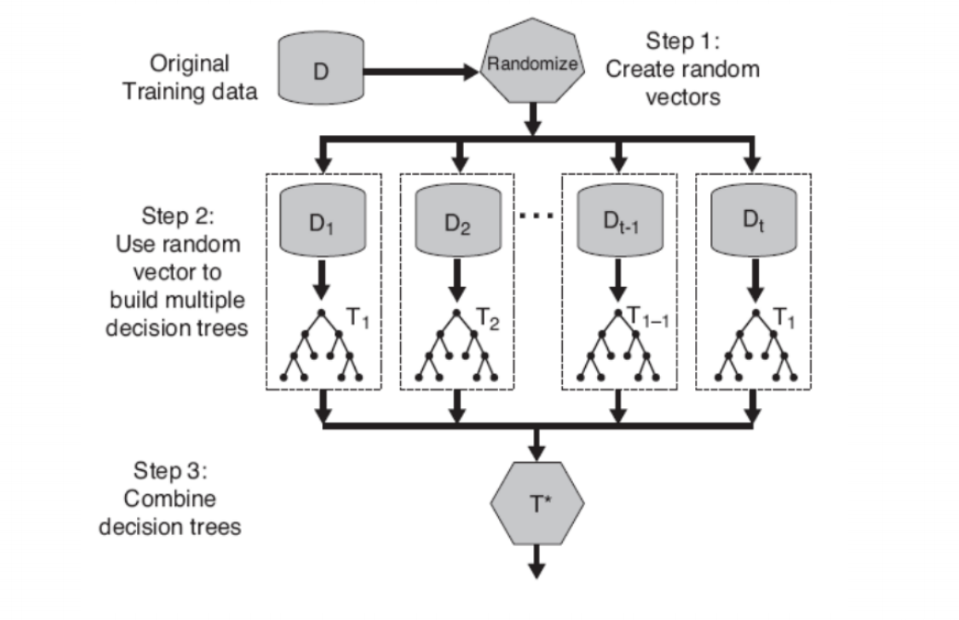
Random Forest

Slide 14
Random Forest
Usage : Ensemble learning method for classification, regression and other tasks, that operate by constructing a multitude of decision trees at training time and outputting the class that is the mode of the classes (classification) or mean prediction (regression) of the individual trees
Package : class sklearn.ensemble.RandomForestClassifier
Command :
class sklearn.ensemble.RandomForestClassifier(n_estimators=10, criterion='gini', max_depth=None,min_samples_split=2, min_samples_leaf=1, min_weight_fraction_leaf=0.0, max_features='auto', max_leaf_nodes=None,bootstrap=True, oob_score=False, n_jobs=1, random_state=None, verbose=0, warm_start=False, class_weight=None)

Slide 15
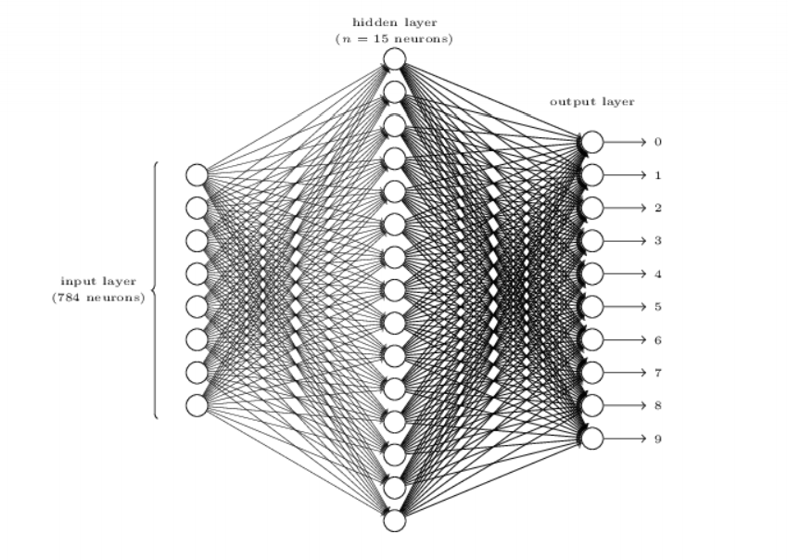
Neural Network

Slide 16
Neural Network
Usage : Models inspired by biological neural networks (the central nervous systems of animals, in particular the brain) and are used to estimate or approximate functions that can depend on a large number of inputs and are generally unknown. Multi-layer Perceptron
Package : class sklearn.neural_network. MLPClassifier
Command :
MLPClassifier(activation='relu', algorithm='l-bfgs', alpha=1e-05, batch_size='auto', beta_1=0.9, beta_2=0.999, early_stopping=False, epsilon=1e-08, hidden_layer_sizes=(5, 2), learning_rate='constant', learning_rate_init=0.001, max_iter=200, momentum=0.9, nesterovs_momentum=True, power_t=0.5, random_state=1, shuffle=True, tol=0.0001, validation_fraction=0.1, verbose=False, warm_start=False)

Slide 17
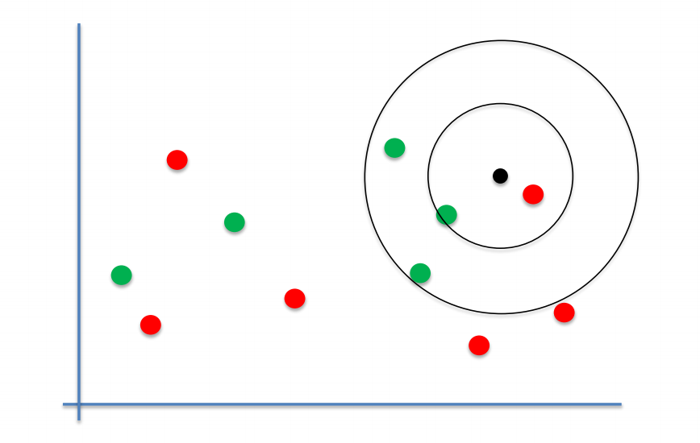
K Nearest Neighbour

Slide 18
k-Nearest Neighbour Regression
Usage : non-parametric method used for classification and regression
Package : class sklearn.neighbors.KNeighborsClassifier
Command :
class sklearn.neighbors.KNeighborsClassifier(n_neighbors=5, weights='uniform', algorithm='auto', leaf_size=30,p=2, metric='minkowski', metric_params=None, n_jobs=1, **kwargs)

Slide 19
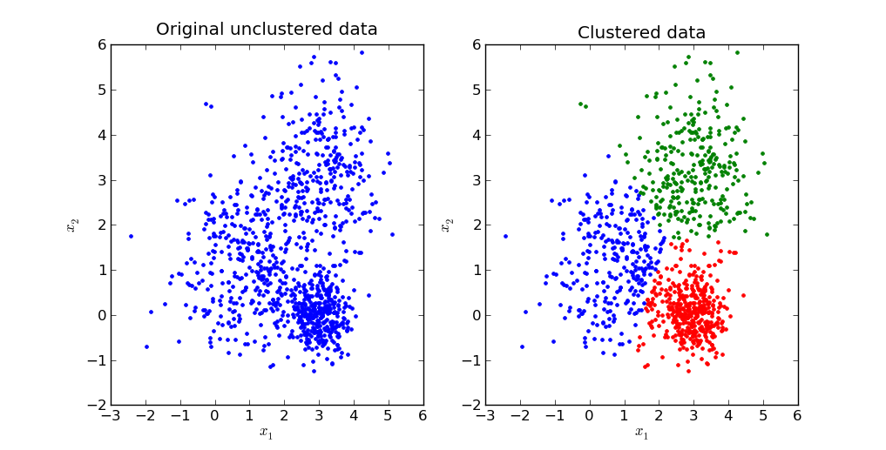
K Means

Slide 20
K-Means Clustering
Usage : Cluster analysis in data mining
Package : class sklearn.cluster.Kmeans
Command :
class sklearn.cluster.Kmeans (n_clusters=8, init ='k-means ++’ ,n_init =10, max_iter =300, tol = 0.0001, precompute_distance = ‘auto’, verbose=0, random_state = None, copy_x=True, n_jobs=1)

Slide 21
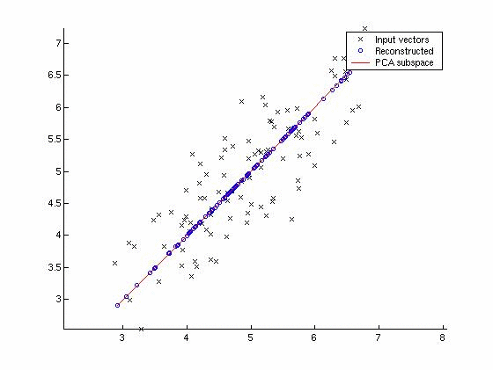
Principal Components Analysis (PCA)

Slide 22
PCA
Usage : Statistical procedure that uses an orthogonal transformation to convert a set of observations of possibly correlated variables into a set of values of linearly uncorrelated variables
Orthogonal Transformation: Linear transformation that preserves the inner product
Package : class sklearn.decomposition.PCA
Command :
class sklearn.cluster.Kmeans (n_clusters=8, init ='k-means ++’ ,n_init =10, max_iter =300, tol = 0.0001, precompute_distance = ‘auto’, verbose=0, random_state = None, copy_x=True, n_jobs=1)

Slide 23
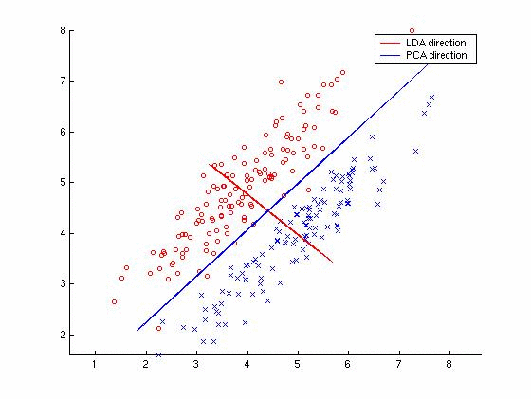
Linear Discriminant Analysis (LDA)

Slide 24
Linear Discriminant Analysis (LDA)
Usage : Method used in statistics, pattern recognition and machine learning to find a linear combination of features that characterizes or separates two or more classes of objects or events
Package : class sklearn.lda.LDA
Command :
class sklearn.lda.LDA(solver='svd', shrinkage=None, priors=None, n_components=None, store_covariance=False,tol=0.0001)

